Slide 1
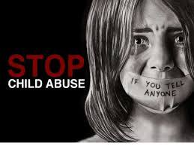
Child Abuse
Student’s Name
Institutional Affiliation
Notes:
The presentation will discuss how child abuse has been presented in “The Girl Next Door” film

Slide 2
Introduction
The rate of child abuse has increased significantly in the United States over the years
Child abuse is the mistreatment of any method to a child that leads to violence or bullying
Domestic violence can also be related to child abuse when it happens at home and with the parents
Children can also be abused by adults such as teachers and other employees they relate with
Child abuse can also be done intentionally
Notes:
The rate at which child abuse happens in the United States is very high and it continues to increase significantly. However, many people do not realize the harm that children undergo through. Child abuse is a mistreatment of any form that can lead to threatening or even violence to a child. Therefore, it is not physical violence alone because domestic violence can also lead to child abuse especially when the parents are the main people involved in abusing their children. While many cases of abuse occur at home, it can also happen in other areas by people that children trust a lot such as teachers. Consequently, it can be done intentionally.

Slide 3
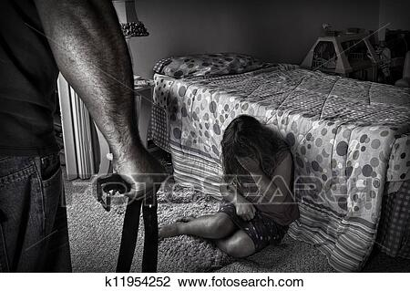
How Children are Abused
Sexual abuse (van der Kolk, 2017)
Physical abuse
Emotional abuse (van der Kolk, 2017)
Child neglect
Notes:
Although children become abused in different ways the most common one that will haunt them a lot is emotionally because it will make them continue feeling unsafe. Many children are abused sexually in different forms such as exposing them to sexual conditions, therefore, it does not necessarily mean body contact (van der Kolk, 2017). Also, another way is physically especially using excessive force in punishment hence hurting and causing harm to a child. Emotional abuse is another way and it involves using hurting words and humiliating and threatening them. This is among the worst because it can cause emotional torture and mental health disorders (van der Kolk, 2017). Finally, child neglect is very critical and most of the time is unrealized since it comprises of not providing basic needs to a child. Most parents are unable because of the situations they are in such as untreated anxiety and drug abuse.

Slide 4
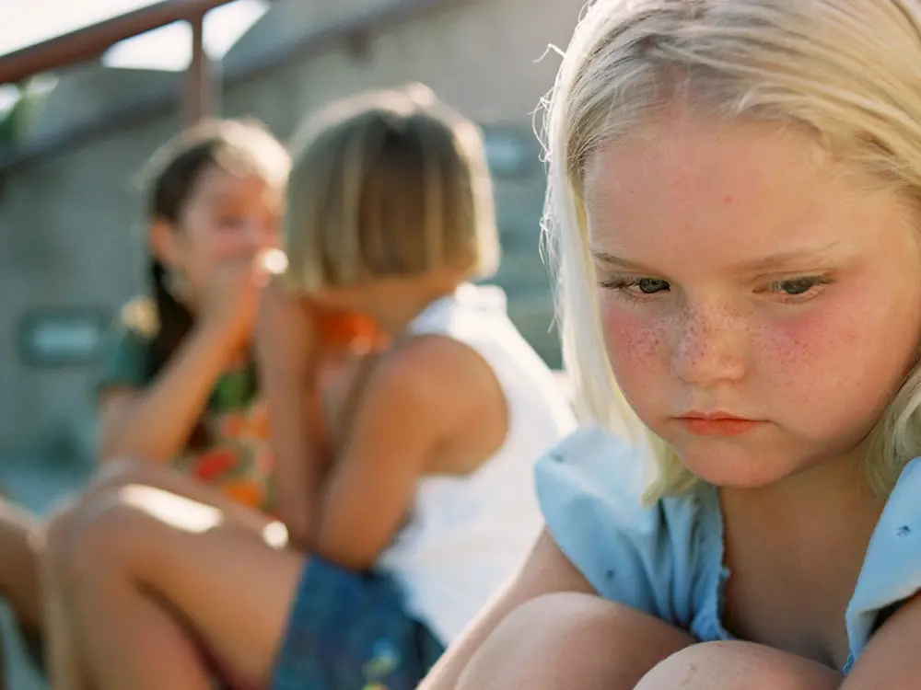
Realizing the Signs of Abuse in A Child
Recurrent injuries and inexplicable bruises (Christian & Committee on Child Abuse and Neglect, 2015)
Tries as much as possible to avoid certain individual
Have poor hygiene and does not want to change clothes
Always late and sometimes misses school
More fearful and does not interact with others
Notes:
According to Christian & Committee on Child Abuse and Neglect (2015), many children are undergoing child abuse but they do not say for fear of not being believed or shame. Therefore, he contended identifying the signs from the child will help in saving them from abuse. Such signs include having recurrent injuries and inexplicable bruises which will indicate a sign of being mistreated physically. Also, sexual harassment on a child can be realized when the child does not want to be involved with a certain person through avoiding them. Furthermore, when they lack basic needs they will always be missing and going to school late as well as have poor hygiene. Similarly, emotional exploitation leads to children becoming more fearful and uneasy when doing somethings as well as not interacting with their peers.

Slide 5
Description of “The Girl Next Door” Film
The film was written based on Jack Ketchum’s novel (Caicedo, 2015)
Two girls moved to stay with their Aunt after their parents died in a car accident
Ruth, the aunt is a single mum with three children (Caicedo, 2015)
With Ruth being involved in drug abuse, she gives beer to her underage children and friends
Ruth was left by the husband to take care of her children
Notes:
The film “The girl next door” which is developed from Jack Ketchum’s novel is based on a true story (Caicedo, 2015). With families passing through a lot when their parents are dead, children left behind and suffer a lot before accepting the situation they are in. However, most of them are taken to live with their relatives in the case of Meg and Susan who are left to stay with their aunt Ruth (Caicedo, 2015). Although Ruth is a single mother with three children Donny, Willie and Woofer, she was is involved in drug abuse such as taking excess alcohol and smoking which ends up providing to their children and their friends.

Slide 6
Description of Child Abuse in the Film
Releases her anger to Meg and Susan by behaving cruelly and coldly on them
Ruth berates Meg and Susan in front of their agemates
Joking about the children’s’ parents’ death and telling Meg she is fat and needs to eat less (Caicedo, 2015)
Meg is tied to the ceiling while blindfolded
Eventually, Meg is teased and asked dirty queries which taunts her
Notes:
Although Ruth works hard to provide for her children, she is suffering from depression due to her husband living her alone to take care of the children. Thus, she releases the anger to Meg and Susan by behaving cruelly and coldly. For instance, Ruth abuses Meg by berating her in front of their sons as well as other children in the neighborhood. Also, Meg is told that she is too fat and should eat less food (Caicedo, 2015). Ruth abuses Meg also when talking jokingly about the death of Meg and Susan’s parents' death. In the end, Meg is tied up to the ceiling and blindfolded and through Ruth encouragement other neighboring children together with her son's teases Meg and ask the dirty questions that taunts her.

Slide 7
Description of Child Abuse in the Film (Continuation)
In the end, it results in torture, rape and humiliation
Although David does not like it, is afraid to act and help Meg (Caicedo, 2015)
When Meg tries to ask for help, she is burned, called dirty slut
Notes:
With the inspirations Ruth provides to the neighboring kids as well as her sons, Meg was abused by being subjected to agony, mortification and even rape. However, the suffering the child passed through is harsh and was against human rights. Furthermore, the unspeakable anguish Meg passed through resulted in death and Susan living with grief and stress since she has no one left in her family. Although David was not happy about what was going on with Meg, he did nothing to help because of fear (Caicedo, 2015). Previously, when Meg asked for help from the authority such as policemen, she was beaten, pinched, burned and called dirty slut.

Slide 8

Why Children are Abused
Involvement in alcohol and drug abuse
Untreated mental ailment (Nemeroff, 2016)
Violence at home
Not having support (Zeanah & Humphreys, 2018)
Not having paternal skills
Notes:
Many cases reported of child mistreatment are brought about by drug abuse because when parents use drugs such as alcohol excessively, they will not be able to make appropriate decisions for their children. Furthermore, when depression and anxiety become severe and untreated may lead to caregivers not able to take care of children as well as being quick to anger (Nemeroff, 2016). Although many parents are working hard towards giving their children a better life, domestic violence can become challenging and thus exposing a child to things that will affect their mental health. Parenting is not an easy job especially if someone is alone because they will have to handle job-related matters as well as caring for children and also other caregivers do not have parenting skills especially if they were raised in an abusive life (Zeanah & Humphreys, 2018).

Slide 9
Other Topics the Film Addresses
Child sexual abuse (Caicedo, 2015)
Drug abuse
Murder
Notes:
Many families are suffering through their children being subjected to sexual abuse with either adults or their peers. Although many peers do not easily involve themselves in a sexual act without influence, many adults are involved in encouraging other children to perform sexual activities to other children. For instance, Ruth influenced her sons and their friends to abuse Meg sexually (Caicedo, 2015). Drug abuse is also presented in the film when Ruth uses alcohol and smokes in front of her children, she also gives her children and their friends' beer to take whereas they have not reached the age limit to use alcohol. Moreover, murder is also a critical topic presented where Meg is tortured and abused until death.

Slide 10
Message Passed
Child abuse can cause increased suffering and also death to children
Many families suffer due to abusive behaviors caused
Identify appropriate age for children to understand the use of drugs such as alcohol
Avoid denial and speaking up
Notes:
Although the film and articles have expressed a lot of information concerning the issue of child abuse, the message passed is that child abuse causes increased suffering to children through either physical and emotional and also death. Meg died due to being abused. Furthermore, many families are subjected to pain and suffering especially when their child is abused, everyone always needs their child to be raised in a good environment. Another message passed is the age at which children should be exposed to drugs such as alcohol and smoking because Ruth does all that information about children and also provides them with it. Moreover, people should avoid denial by speaking up, David could speak up but did not hence live in denial.

Slide 11
Conclusion
Child abuse has caused increased suffering to children and families in general
Children are abused in different ways including sexual, physical, neglect and emotionally
“The girl next door” film has expressed how families suffer from child abuse
Torture, humiliation and rape can cause death to a child
Drug abuse, lack of support can lead to child abuse
Notes:
Child abuse is a very critical issue that affects both children and families significantly. Although the government is working towards reducing the rate, many children are abused physically, sexually, emotionally and neglected. However, pain, suffering, stress and depression are the results of child abuse. Meg and Sarah are an example of a family that has passed through child abuse, although Meg died due to humiliation, rape and torture subjected to by her aunt Ruth, Sarah survived but was left passing through a lot of suffering for not having anybody of their family by her side. Ruth was involved in drug abuse such as smoking and alcohol taking as well as left to care for her sons which are some of the reasons that led to abusing Meg.

Slide 12
References
Caicedo, C. (2015). The Girl Next Door 2007. https://www.youtube.com/watch?v=KVTC9MASjqk&has_verified=1
Christian, C. W., & Committee on Child Abuse and Neglect. (2015). The evaluation of suspected child physical abuse. Pediatrics, 135(5), e1337-e1354.
Fotosearch.com. https:www.fotosearch.com/CSP991/k11954252/
Nemeroff, C. B. (2016). Paradise lost: the neurobiological and clinical consequences of child abuse and neglect. Neuron, 89(5), 892-909.
van der Kolk, B. A. (2017). This issue: child abuse & victimization. Psychiatric Annals, 35(5), 374-378.
Zeanah, C. H., & Humphreys, K. L. (2018). Child abuse and neglect. Journal of the American Academy of Child & Adolescent Psychiatry, 57(9), 637-644.

